Slide 1
GEOMETRIC CAMERA MODEL

Slide 2
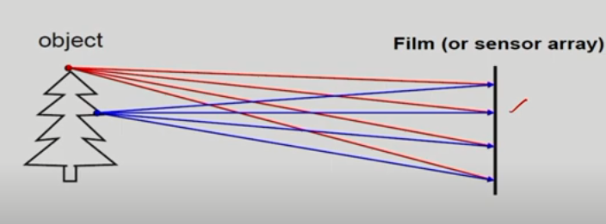
Simple Image Formation
Blurred Image because of intersections of rays

Slide 3
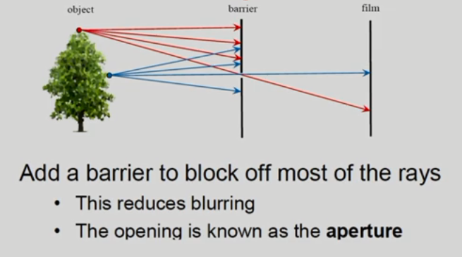
Image Formation
Another scenario with a barrier

Slide 4
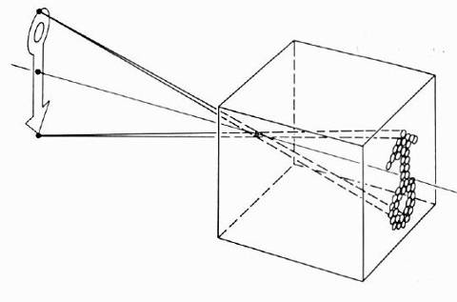
Pinhole camera model
Pinhole model:
Captures pencil of rays – all rays through a single point
The point is called Center of Projection (focal point)
The image is formed on the Image Plane
Slide by Steve Seitz

Slide 5
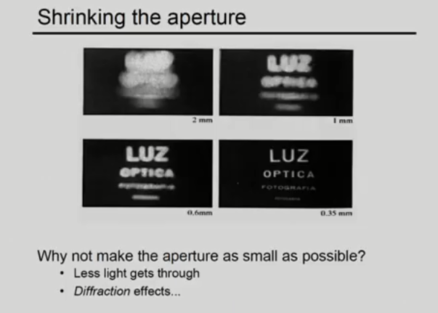
Image Formation

Slide 6
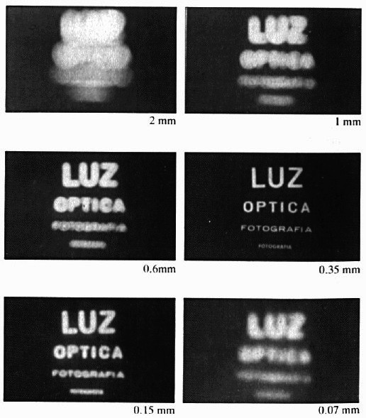
Image Formation
Shrinking the aperture

Slide 7
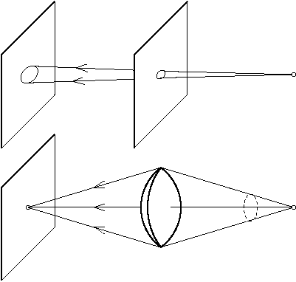
The Reason For Lenses
A pinhole camera is a simple camera without a lens but with a tiny aperture (the so-called pinhole). Light from a scene passes through the aperture and projects an inverted image on the opposite side of the box, which is known as the camera obscura effect.
Lenses are essential optical elements in image formation, as they allow more light to be captured by the sensor while still maintaining the sharpness of the image

Slide 8
Image Formation
A lens focuses light onto the film
Rays passing through the center are not deviated
Slide by Steve Seitz

Slide 9
Image Formation
focal point
f
A lens focuses light onto the film
Rays passing through the center are not deviated
All parallel rays converge to one point on a plane located at the focal length f
Slide by Steve Seitz

Slide 10
Image Formation
“circle of
confusion”
A lens focuses light onto the film
There is a specific distance at which objects are “in focus”
other points project to a “circle of confusion” in the image
Changing the shape of the lens changes this distance
Slide by Steve Seitz

Slide 11
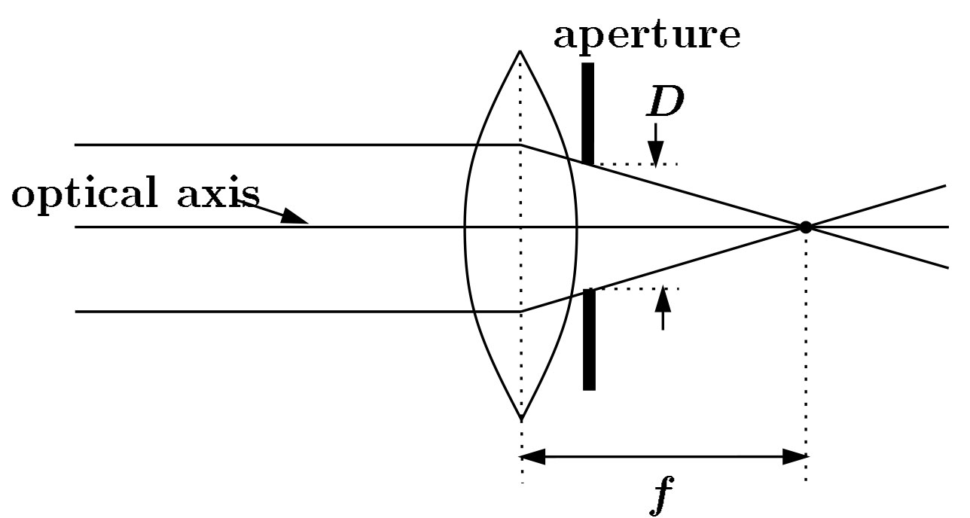
Image Formation
F
focal point
optical center
(Center Of Projection)
A lens focuses parallel rays onto a single focal point
focal point at a distance f beyond the plane of the lens
f is a function of the shape and index of refraction of the lens
Aperture of diameter D restricts the range of rays
aperture may be on either side of the lens
Lenses are typically spherical (easier to produce)
Real cameras use many lenses together (to correct for aberrations)

Slide 12
Thin lens formula
D’
D
f
Frédo Durand’s slide

Slide 13
Thin lens formula
Similar triangles everywhere!
D’
D
f
Frédo Durand’s slide

Slide 14
Thin lens formula
y’/y = D’/D
Similar triangles everywhere!
D’
D
f
y
y’
Frédo Durand’s slide

Slide 15
Thin lens formula
y’/y = D’/D
Similar triangles everywhere!
y’/y = (D’-f)/f
D’
D
f
y
y’
Frédo Durand’s slide

Slide 16
Thin lens formula
1
1
1
Any point satisfying the thin lens equation is in focus.
+
=
D’
D
f
D’
D
f
Frédo Durand’s slide

Slide 17
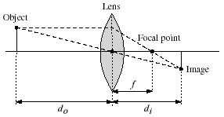
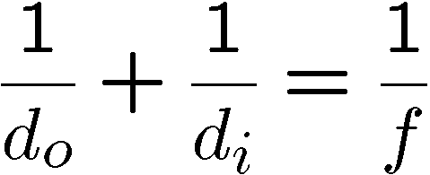
Thin lenses
Thin lens equation:
Any object point satisfying this equation is in focus
What is the shape of the focus region?
How can we change the focus region?
Notes:
manipulate eq to show shape of focus region

Slide 18
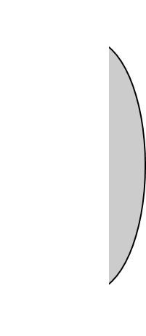
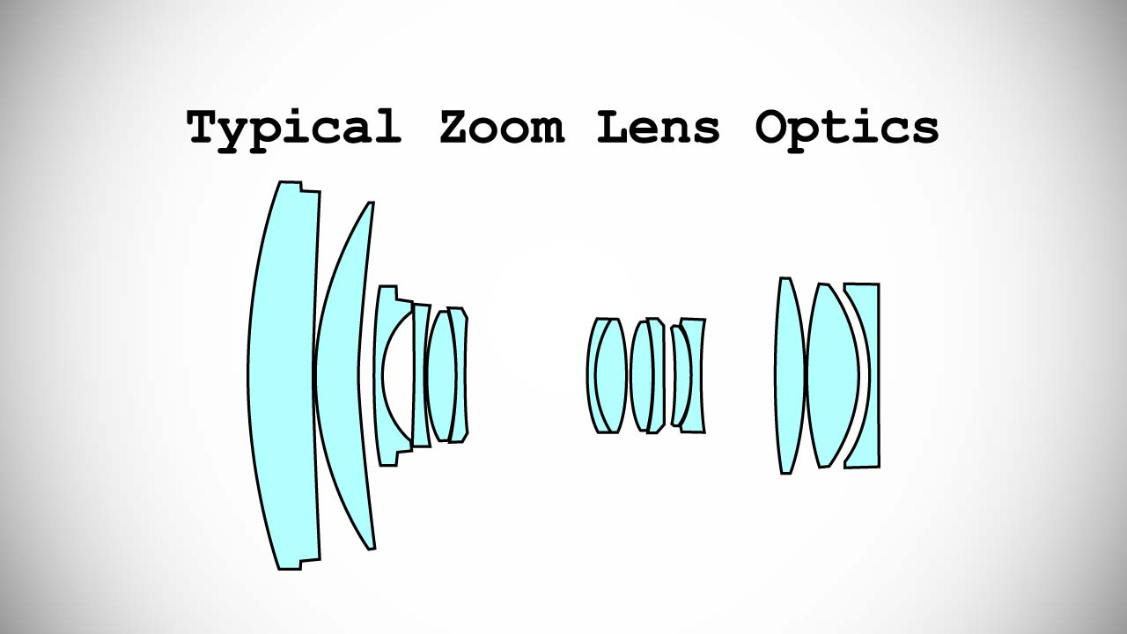
Thin lens assumption
The thin lens assumption assumes the lens has no thickness, but this isn’t true…
Object
Lens
Film
Focal point
By adding more elements to the lens, the distance at which a scene is in focus can be made roughly planar.

Slide 19
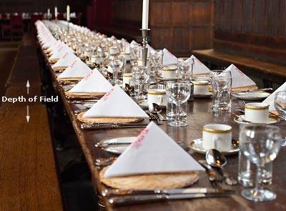
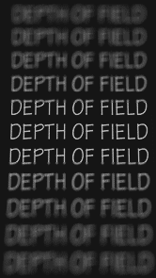
Depth of Field
http://www.cambridgeincolour.com/tutorials/depth-of-field.htm
Slide by A. Efros

Slide 20
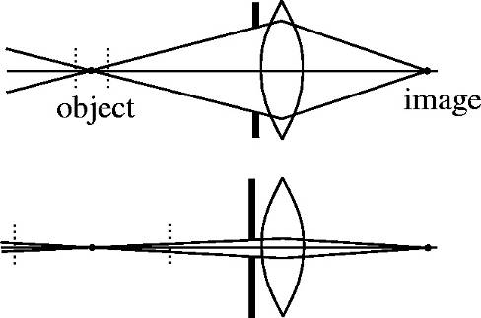
How can we control the depth of field?
Changing the aperture size affects depth of field
A smaller aperture increases the range in which the object is approximately in focus
But small aperture reduces amount of light – need to increase exposure
Slide by A. Efros

Slide 21
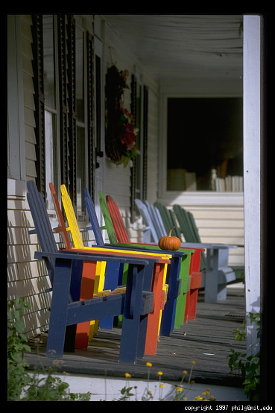
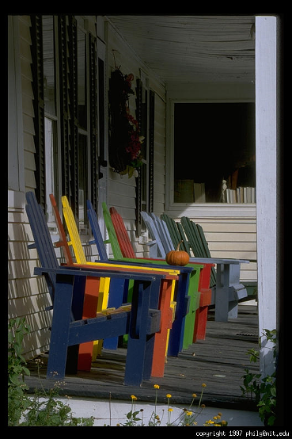
Varying the aperture
Large aperture = small DOF
Small aperture = large DOF
Slide by A. Efros

Slide 22


Depth of field
Aperture
Film
f / 5.6
f / 32
Changing the aperture size affects depth of field
A smaller aperture increases the range in which the object is approximately in focus
Flower images from Wikipedia http://en.wikipedia.org/wiki/Depth_of_field

Slide 23


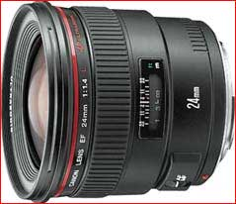
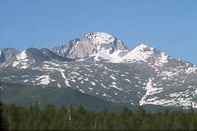
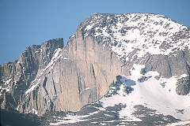
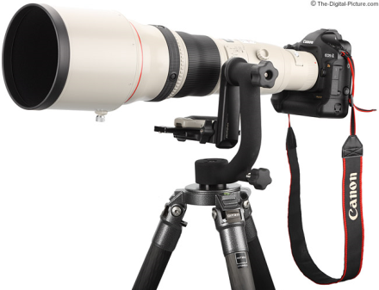
Focal length
Can think of as “zoom”
Related to field of view
24mm
50mm
200mm
800mm

Slide 24
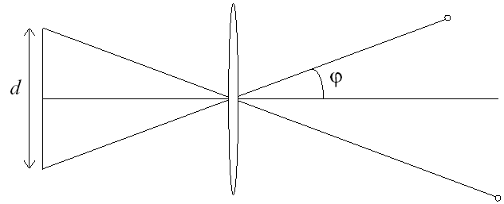
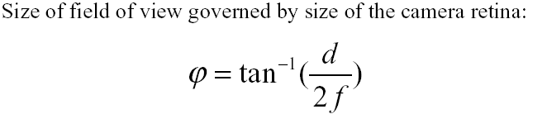
Field of View
f
f
FOV depends on focal length and size of the camera retina
Smaller FOV = larger Focal Length
Slide by A. Efros

Slide 25
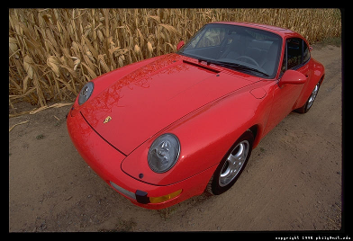
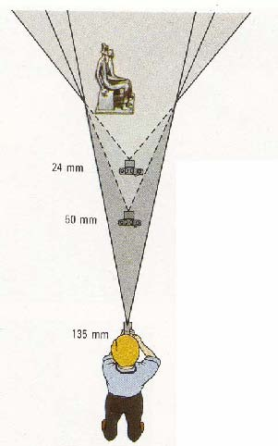
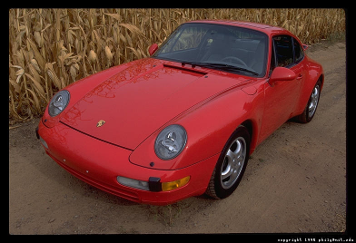
Field of View / Focal Length
Large FOV, small f
Camera close to car
Small FOV, large f
Camera far from the car
Sources: A. Efros, F. Durand

Slide 26
Field of View (Zoom)
Slide by A. Efros

Slide 27
Field of View (Zoom)
Slide by A. Efros

Slide 28



Same effect for faces
wide-angle
standard
telephoto
Source: F. Durand

Slide 29
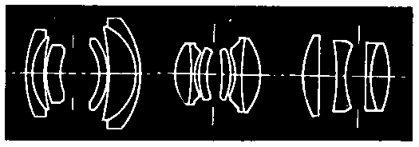
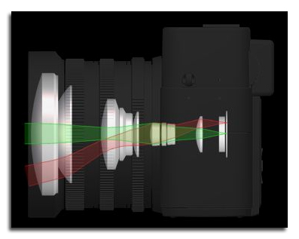
Lens systems
A good camera lens may contain 15 elements and cost a thousand dollars
The best modern lenses may contain aspherical elements

Slide 30
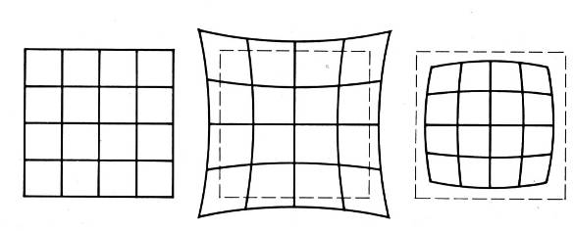
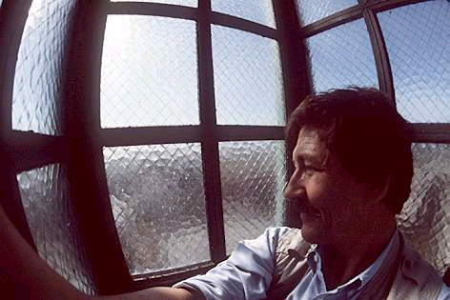
Radial Distortion
Caused by imperfect lenses
Deviations are most noticeable for rays that pass through the edge of the lens
No distortion
Pin cushion
Barrel

Slide 31
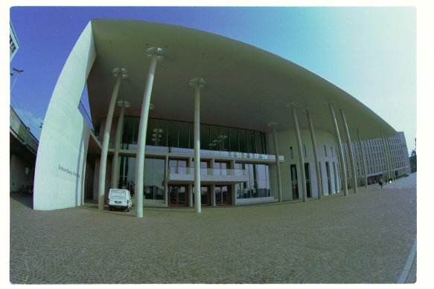
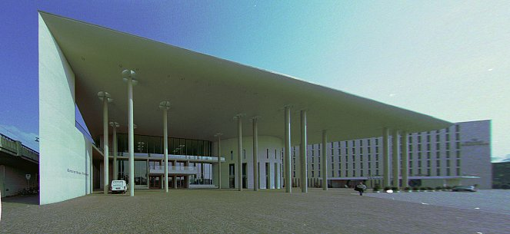
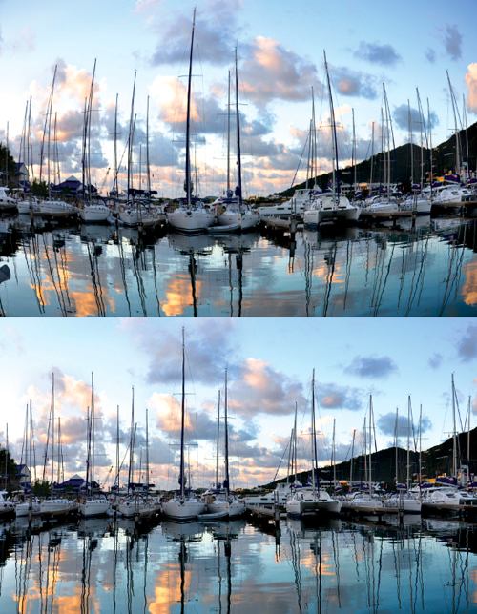
Correcting radial distortion
from Helmut Dersch

Slide 32

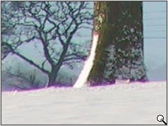
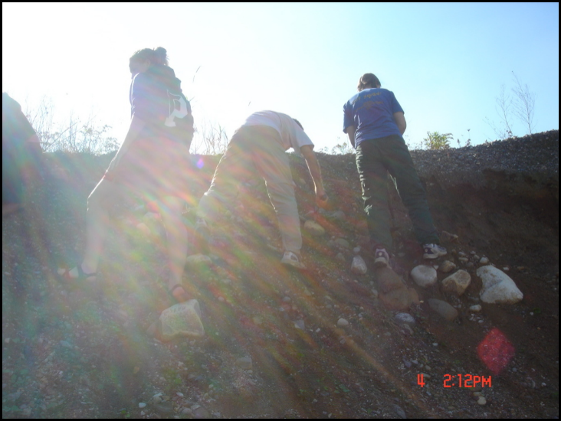
Other Types of Distortion
Lens Vignetting
Chromatic Aberrations
Lens Glare
[Slide adapted from Srinivasa Narasimhan]

Slide 33
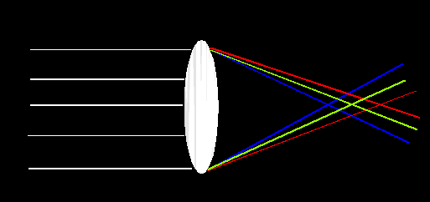
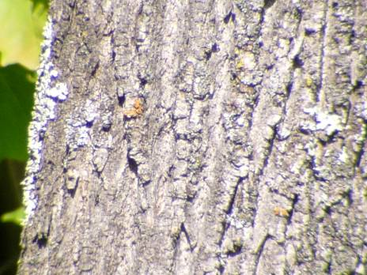
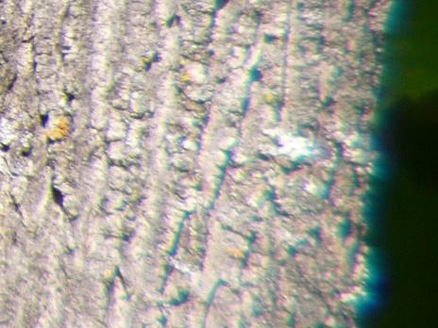
Lens Flaws: Chromatic Aberration
Lens has different refractive indices for different wavelengths: causes color fringing
Near Lens Center
Near Lens Outer Edge

Slide 34
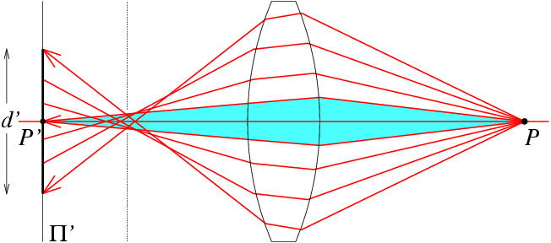
Lens flaws: Spherical aberration
Spherical lenses don’t focus light perfectly
Rays farther from the optical axis focus closer

Slide 35
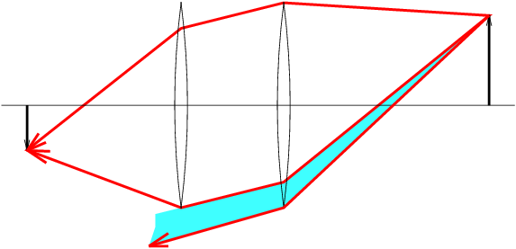
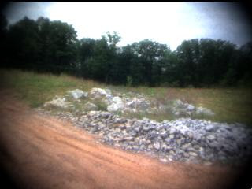

Lens flaws: Vignetting

Slide 36
This NPTEL video can be referenced for this topic.
https://www.youtube.com/watch?v=Zgv-zQzMkUE

Slide 37
THANK YOU

